Slide 1
CDK Data Stream AI
Winter Progress Report
Group 65
Jacob Geddings, Inhyuk Lee, Juan Mugica

Slide 2
Introduction
What is Our Project:
The creation of a program that, when submitted a form, can scan and determine if a signature line is present and then judge whether the signature line possesses a binding mark.
Our client is CDK Global that have an interest in improving accuracy and response time to potentially missed signatures on their documents.
Layout of Progress Report:
Introduction Non-code Progress Goals General Problem and Solution OCR Tesseract Demo Part 1 Convolutional Network Demo Part 2

Slide 3
What We Have Been Doing Outside of Code
Scheduling:
Schedules have been changed, new meeting times established for:
TA: 1:00pm to 1:20pm on Thursdays
Client: 2:30pm to 3:00pm on Thursdays
Group Meetings: 3:00pm to 4:00pm on MWF

Slide 4
What We Have Been Doing Outside of Code
Restructuring:
GitHub Repository has gone under a signficiant overhaul in preperation for showing to our client.
Locked in a format for accomplishing our main objective:
Image Conversion -> OCR Tesseract -> Convolutional Network -> Result

Slide 5
Goals - What remains to be done
Fine Tuning of Network:
Need to expand on training set to improve accuracy
Include a greater variety of forms to ensure it can work with different setups
Some stretch goals we now have in sight include:
Multi-form recognition
License detection

Slide 6
Problems and Solutions Overview
Some general notes on problems we have encountered:
Version differences have during installation
Installation of key software has proven difficult
Document layout was able to confuse certain parts of program

Slide 7
Locating Signature Box
The main idea
Page analysis
Convert image to text
Search: Signature
Document 1
The is an example document that we want to show how our signature location program works.
Document 1
The is an example document that we want to show how our signature location program works.
Document 1
The is an example document that we want to show how our signature location program works.
Signature
Signature
Signature

Slide 8
Locating Signature Box
Software and technique
Tech: OCR Optical character recognition (OCR) is a technique of converting images to machine encoded text. -This is commonly used technique to convert image to text. | Software: ImageMagic ImageMagic is free and open source software that can create, edit, compose, or convert bitmap images. -Supports 11 different image types -It supports different programming languages including C++, Java, and Python | OCR Tesseract OCR Tesseract is an open source free character recognition engine. -Supports 10 different programming language -Recognize more than 100 different languages -Trainable

Slide 9
Signature location alpha program demo

Slide 10
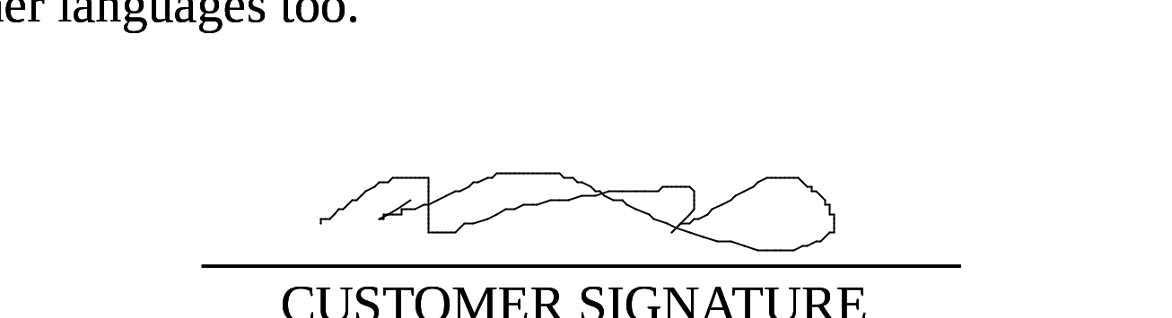
Limitation and possible solution
Search Method Every documents have different signature box format. 1. Make list of keywords Corruption of keywords by signature 2. Take similar words “CUSTOMER SIGNATURE” = “CUST@MER S!GNATURE” | Cutting Signature box We cut signature box by manually set area. 1. Locate the keywords 2. Locate the closest horizontal line 3. Cut above and below the horizontal line

Slide 11
Convolutional Network
- In order to detect whether or not a certain image is of a signature we will be utilizing a Convolutional Neural Network
- Specifically designed for object detected
- Heavily supported by OpenCV

Slide 12
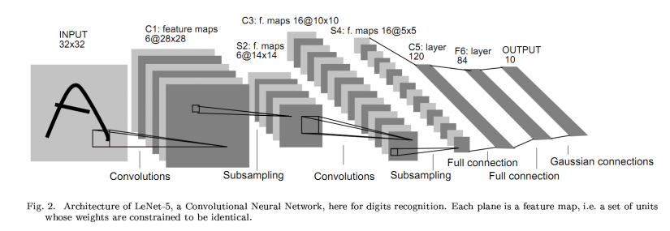
Architecture
- Five layers:
-Convolutional Layer
-Pooling layer
-ReLu layer (Rectified Linear Units)
- Softmax regression
- Fully connected layer

Slide 13
Convolutional Layer
Applying a feature kernel
Combining new values into a convolved image
Displaying

Slide 14
Implementation
- Eric Yuann’s convolutional neural network
- Originally designed for understanding the MNIST handwritten data set
- Debug / complete / implement

Slide 15
Challenges
- Understanding the MNIST ubyte format for unzipping
- Understanding Eric Yuann’s specific implementation of the Conv Net
- Back engineering the specific methods to suit our purposes
- Splitting training and testing
- Creating kernel loading capability
- Redefining input detection to fit .PNG format

